Slide 1

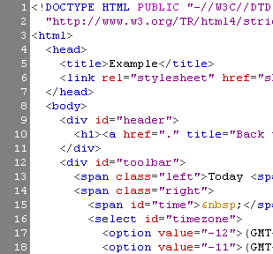


HTML Basics
HTML, Text, Images, Tables, Forms
www.telerik.com

Slide 2
Table of Contents
Introduction to HTML
How the Web Works?
What is a Web Page?
My First HTML Page
Basic Tags: Hyperlinks, Images, Formatting
Headings and Paragraphs
HTML in Details
The <!DOCTYPE> Declaration
The <head> Section: Title, Meta, Script, Style
Notes:
All HTML documents must start with a <!DOCTYPE> declaration. The declaration is not an HTML tag. It is an "information" to the browser about what document type to expect.

Slide 3
Table of Contents (2)
The <body> Section
Text Styling and Formatting Tags
Hyperlinks: <a>
Hyperlinks and Sections
Images: <img>
Lists: <ol>, <ul> and <dl> description list
HTML Special Characters
The <div> and <span> elements
Define parts of a document, they are identifiable when a unique classification is necessary.
Notes:
The <a> tag defines a hyperlink, which is used to link from one page to another. The most important attribute of the <a> element is the href attribute

Slide 4
What is a Web Page?
Web pages are text files containing HTML
HTML – Hyper Text Markup Language
A notation for describing
document structure (semantic markup)
formatting (presentation markup)
Looks (looked?) like:
A Microsoft Word document
The markup tags provide information about the page content structure
Notes:
semantic markup is HTML that introduces meaning to the web page rather than just presentation

Slide 5
Creating HTML Pages
An HTML file must have an .htm or .html file extension
HTML files can be created with text editors:
NotePad, NotePad ++, PSPad
Or HTML editors (WYSIWYG Editors):
Microsoft FrontPage
Macromedia Dreamweaver
Netscape Composer
Microsoft Word

Slide 6



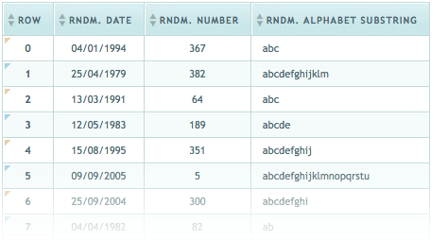

HTML Basics
Text, Images, Tables, Forms

Slide 7
HTML Structure
HTML is comprised of “elements” and “tags”
Begins with <html> and ends with </html>
Elements (tags) are nested one inside another:
Tags have attributes:
HTML describes structure using two main sections:
<head> and <body>
<html> <head></head> <body></body> </html>
<img src="logo.jpg" alt="logo" />
Notes:
HTML tags are used to hold the HTML element. HTML element holds the content. HTML attributes are used to describe the characteristic of an HTML element in detail.

Slide 8
HTML Code Formatting
The HTML source code should be formatted to increase readability and facilitate debugging.
Every block element should start on a new line.
Every nested (block) element should be indented.
Browsers ignore multiple whitespaces in the page source, so formatting is harmless.
For performance reasons, formatting can be sacrificed.

Slide 9
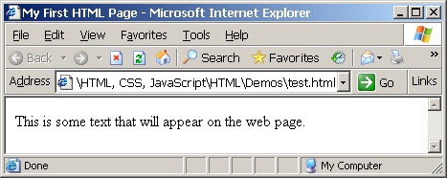
First HTML Page
test.html
<!DOCTYPE HTML>
<html>
<head>
<title>My First HTML Page</title>
</head>
<body>
<p>This is some text...</p>
</body>
</html>

Slide 10
First HTML Page: Tags
<!DOCTYPE HTML>
<html>
<head>
<title>My First HTML Page</title>
</head>
<body>
<p>This is some text...</p>
</body>
</html>
Opening tag
Closing tag
An HTML element consists of an opening tag, a closing tag and the content inside.

Slide 11
First HTML Page: Header
HTML header
<!DOCTYPE HTML>
<html>
<head>
<title>My First HTML Page</title>
</head>
<body>
<p>This is some text...</p>
</body>
</html>

Slide 12
First HTML Page: Body
<!DOCTYPE HTML>
<html>
<head>
<title>My First HTML Page</title>
</head>
<body>
<p>This is some text...</p>
</body>
</html>
HTML body

Slide 13
Some Simple Tags
Hyperlink Tags
Image Tags
Text formatting tags
<a href="http://www.telerik.com/"
title="Telerik">Link to Telerik Web site</a>
<img src="logo.gif" alt="logo" />
This text is <em>emphasized.</em>
<br />new line<br />
This one is <strong>more emphasized.</strong>
Notes:
The required src attribute specifies the path (URL) to the image. Note: When a web page loads, it is the browser, at that moment, that gets the image from a web

Slide 14
Some Simple Tags – Example
some-tags.html
<!DOCTYPE HTML>
<html>
<head>
<title>Simple Tags Demo</title>
</head>
<body>
<a href="http://www.telerik.com/" title=
"Telerik site">This is a link.</a>
<br />
<img src="logo.gif" alt="logo" />
<br />
<strong>Bold</strong> and <em>italic</em> text.
</body>
</html>

Slide 15
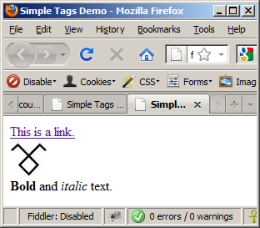
Some Simple Tags – Example (2)
some-tags.html
<!DOCTYPE HTML>
<html>
<head>
<title>Simple Tags Demo</title>
</head>
<body>
<a href="http://www.telerik.com/" title=
"Telerik site">This is a link.</a>
<br />
<img src="logo.gif" alt="logo" />
<br />
<strong>Bold</strong> and <em>italic</em> text.
</body>
</html>

Slide 16


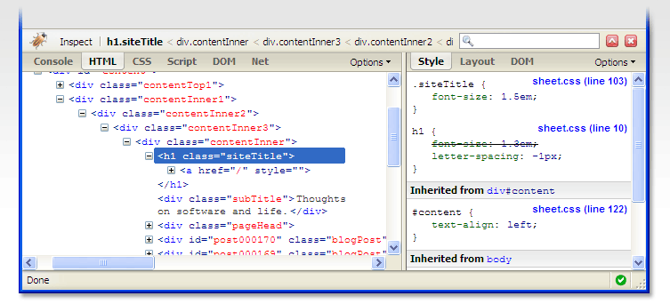

Some HTML Tags
Live Demo

Slide 17
Tags Attributes
Tags can have attributes
Attributes specify properties and behavior
Example:
Few attributes can apply to every element:
id, style, class, title
The id is unique in the document
Content of title attribute is displayed as hint when the element is hovered with the mouse
Some elements have obligatory attributes
Attribute alt with value "logo"
<img src="logo.gif" alt="logo" />
Notes:
The alt attribute specifies an alternate text for an area, if the image cannot be displayed.
The alt attribute specifies an alternate text for an area, if the image cannot be displayed.

Slide 18
Headings and Paragraphs
Heading Tags (h1 – h6)
Paragraph Tags
Sections: div and span
<h1>Heading 1</h1>
<h2>Sub heading 2</h2>
<h3>Sub heading 3</h3>
<p>This is my first paragraph</p>
<p>This is my second paragraph</p>
<div style="background: skyblue;">
This is a div</div>

Slide 19
<div> tag
The <div> tag defines a division or a section in an HTML document.
The <div> tag is used as a container for HTML elements - which is then styled with CSS or manipulated with JavaScript.
The <div> tag is easily styled by using the class or id attribute.

Slide 20
div and span
<!DOCTYPE html>
<html>
<head>
<style>
.myDiv {
border: 5px outset red;
background-color: lightblue;
text-align: center;
}
</style>
</head>
<body>
<h1>The div element</h1>
<div class="myDiv">
<h2>This is a heading in a div element</h2>
<p>This is some text in a div element.</p>
</div>
<p>This is some text outside the div element.</p>
</body>
</html>

Slide 21
Headings and Paragraphs – Example
headings.html
<!DOCTYPE HTML>
<html>
<head><title>Headings and paragraphs</title></head>
<body>
<h1>Heading 1</h1>
<h2>Sub heading 2</h2>
<h3>Sub heading 3</h3>
<p>This is my first paragraph</p>
<p>This is my second paragraph</p>
<div style="background:skyblue">
This is a div</div>
</body>
</html>

Slide 22
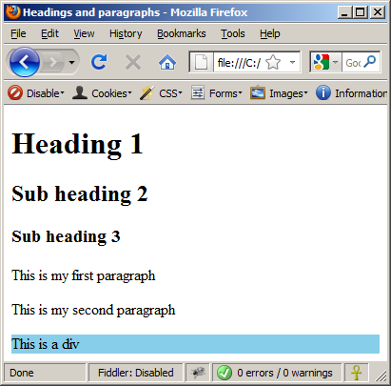
Headings and Paragraphs – Example (2)
headings.html
<!DOCTYPE HTML>
<html>
<head><title>Headings and paragraphs</title></head>
<body>
<h1>Heading 1</h1>
<h2>Sub heading 2</h2>
<h3>Sub heading 3</h3>
<p>This is my first paragraph</p>
<p>This is my second paragraph</p>
<div style="background:skyblue">
This is a div</div>
</body>
</html>

Slide 23

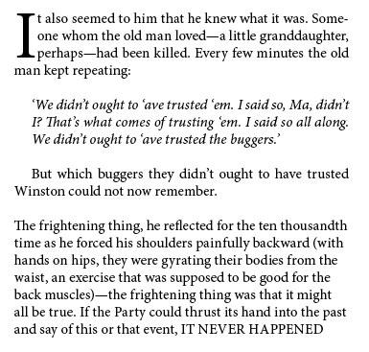
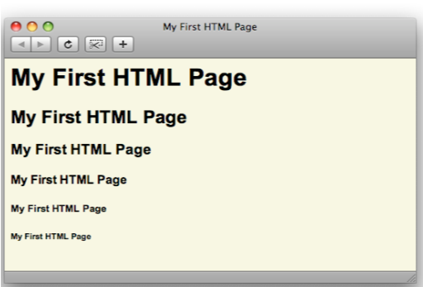
Headings and Paragraphs
Live Demo

Slide 24
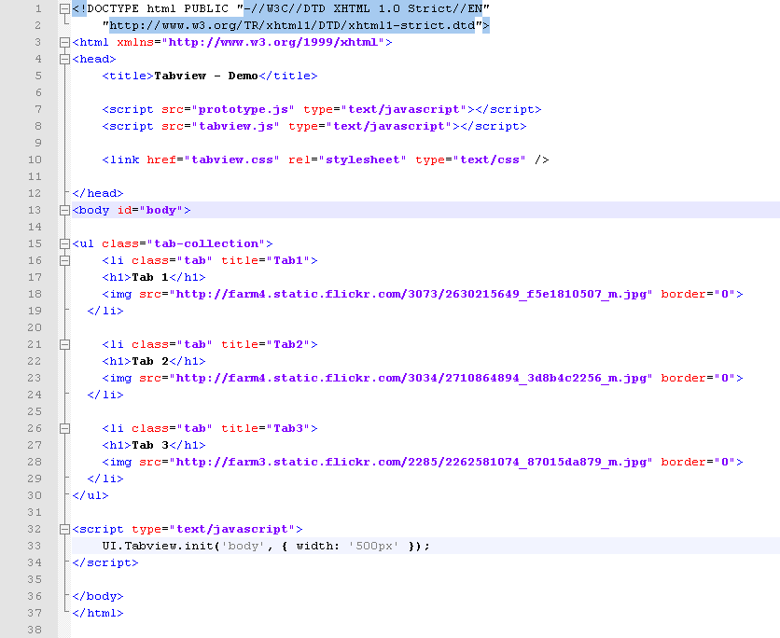
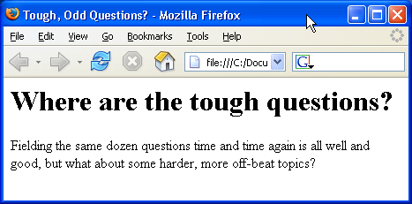
Introduction to HTML
HTML Document Structure in Depth

Slide 25
Preface
It is important to have the correct vision and attitude towards HTML
HTML is only about structure, not appearance

Slide 26

HTML vs. XHTML
XHTML is more strict than HTML
Tags and attribute names must be in lowercase
All tags must be closed (<br/>, <img/>) while HTML allows <br> and <img> and implies missing closing tags (<p>par1 <p>par2)
XHTML allows only one root <html> element (HTML allows more than one)

Slide 27

<head> Section: <title> tag
Title should be placed between <head> and </head> tags
Used to specify a title in the window titlebar
Search engines and people rely on titles
<title>Telerik Academy – Winter Season 2009/2010 </title>

Slide 28
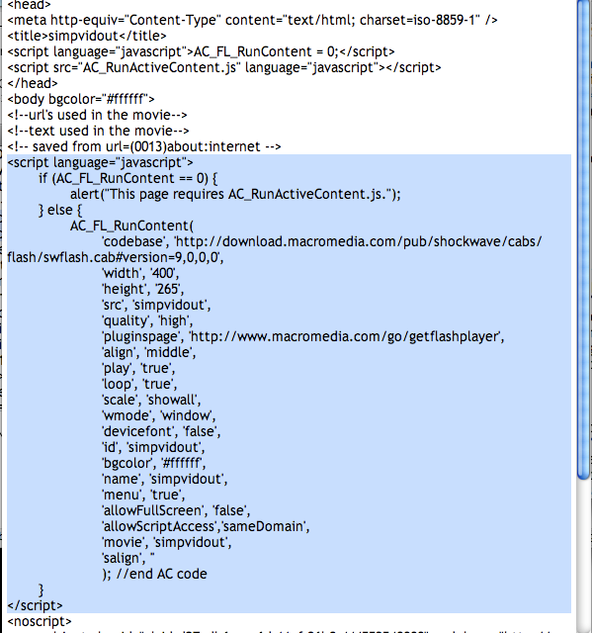




Using Scripts
Live Demo

Slide 29
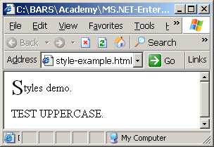
<head> Section: <style>
The <style> element embeds formatting information (CSS styles) into an HTML page
style-example.html
<html>
<head>
<style type="text/css">
p { font-size: 12pt; line-height: 12pt; }
p:first-letter { font-size: 200%; }
span { text-transform: uppercase; }
</style>
</head>
<body>
<p>Styles demo.<br />
<span>Test uppercase</span>.
</p>
</body>
</html>

Slide 30

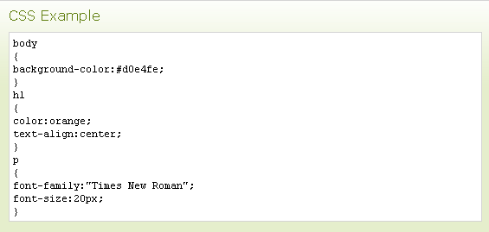


Embedding CSS Styles
Live Demo

Slide 31
Comments: <!-- --> Tag
Comments can exist anywhere between the <html></html> tags
Comments start with <!-- and end with -->
<!–- Telerik Logo (a JPG file) -->
<img src="logo.jpg" alt=“Telerik Logo">
<!–- Hyperlink to the web site -->
<a href="http://telerik.com/">Telerik</a>
<!–- Show the news table -->
<table class="newstable">
...

Slide 32
<body> Section: Introduction
The <body> section describes the viewable portion of the page
Starts after the <head> </head> section
Begins with <body> and ends with </body>
<html>
<head><title>Test page</title></head>
<body>
<!-- This is the Web page body -->
</body>
</html>

Slide 33
Text Formatting
Text formatting tags modify the text between the opening tag and the closing tag
Ex. <b>Hello</b> makes “Hello” bold
<b></b> | bold
<i></i> | italicized
<u></u> | underlined
<sup></sup> | Sample^{superscript}
<sub></sub> | Sample_{subscript}
<strong></strong> | strong
<em></em> | emphasized
<pre></pre> | Preformatted text
<blockquote></blockquote> | Quoted text block
<del></del> | Deleted text – strike through
‹#›

Slide 34
Text Formatting – Example
text-formatting.html
<!DOCTYPE html PUBLIC "-//W3C//DTD XHTML 1.0 Transitional//EN"
"http://www.w3.org/TR/xhtml1/DTD/xhtml1-transitional.dtd">
<html>
<head>
<title>Page Title</title>
</head>
<body>
<h1>Notice</h1>
<p>This is a <em>sample</em> Web page.</p>
<p><pre>Next paragraph:
preformatted.</pre></p>
<h2>More Info</h2>
<p>Specifically, we’re using XHMTL 1.0 transitional.<br />
Next line.</p>
</body>
</html>

Slide 35
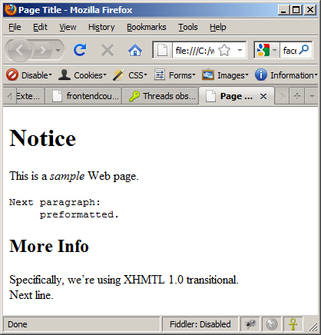
Text Formatting – Example (2)
text-formatting.html
<!DOCTYPE html PUBLIC "-//W3C//DTD XHTML 1.0 Transitional//EN"
"http://www.w3.org/TR/xhtml1/DTD/xhtml1-transitional.dtd">
<html>
<head>
<title>Page Title</title>
</head>
<body>
<h1>Notice</h1>
<p>This is a <em>sample</em> Web page.</p>
<p><pre>Next paragraph:
preformatted.</pre></p>
<h2>More Info</h2>
<p>Specifically, we’re using XHMTL 1.0 transitional.<br />
Next line.</p>
</body>
</html>

Slide 36
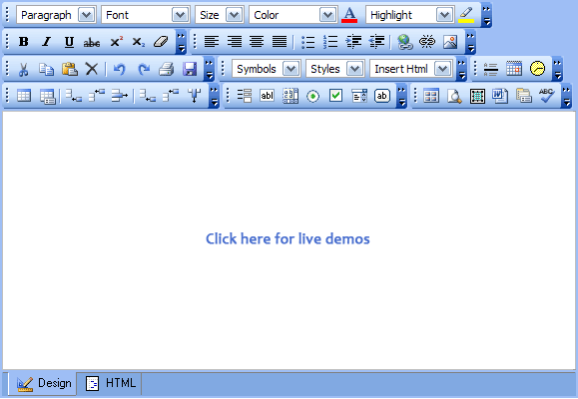




Text Formatting
Live Demo

Slide 37
Hyperlinks: <a> Tag
Link to a document called form.html on the same server in the same directory:
Link to a document called parent.html on the same server in the parent directory:
Link to a document called cat.html on the same server in the subdirectory stuff:
<a href="form.html">Fill Our Form</a>
<a href="../parent.html">Parent</a>
<a href="stuff/cat.html">Catalog</a>

Slide 38
Hyperlinks: <a> Tag (2)
Link to an external Web site:
Always use a full URL, including "http://", not just "www.somesite.com"
Using the target="_blank" attribute opens the link in a new window
Link to an e-mail address:
<a href="http://www.devbg.org" target="_blank">BASD</a>
<a href="mailto:bugs@example.com?subject=Bug+Report">
Please report bugs here (by e-mail only)</a>

Slide 39
Hyperlinks: <a> Tag (3)
Link to a document called apply-now.html
On the same server, in same directory
Using an image as a link button:
Link to a document called index.html
On the same server, in the subdirectory english of the parent directory:
<a href="apply-now.html"><img
src="apply-now-button.jpg" /></a>
<a href="../english/index.html">Switch to English version</a>

Slide 40
Hyperlinks and Sections
Link to another location in the same document:
Link to a specific location in another document:
<a href="#section1">Go to Introduction</a>
...
<h2 id="section1">Introduction</h2>
<a href="chapter3.html#section3.1.1">Go to Section 3.1.1</a>
<!–- In chapter3.html -->
...
<div id="section3.1.1">
<h3>3.1.1. Technical Background</h3>
</div>

Slide 41
Hyperlinks – Example
hyperlinks.html
<a href="form.html">Fill Our Form</a> <br />
<a href="../parent.html">Parent</a> <br />
<a href="stuff/cat.html">Catalog</a> <br />
<a href="http://www.devbg.org" target="_blank">BASD</a> <br />
<a href="mailto:bugs@example.com?subject=Bug Report">Please report bugs here (by e-mail only)</a>
<br />
<a href="apply-now.html"><img src="apply-now-button.jpg” /></a> <br />
<a href="../english/index.html">Switch to English version</a> <br />

Slide 42
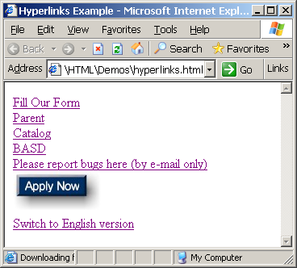
Hyperlinks – Example (2)
hyperlinks.html
<a href="form.html">Fill Our Form</a> <br />
<a href="../parent.html">Parent</a> <br />
<a href="stuff/cat.html">Catalog</a> <br />
<a href="http://www.devbg.org" target="_blank">BASD</a> <br />
<a href="mailto:bugs@example.com?subject=Bug Report">Please report bugs here (by e-mail only)</a>
<br />
<a href="apply-now.html"><img src="apply-now-button.jpg” /></a> <br />
<a href="../english/index.html">Switch to English version</a> <br />

Slide 43





Hyperlinks
Live Demo

Slide 44
Links to the Same Document – Example
links-to-same-document.html
<h1>Table of Contents</h1>
<p><a href="#section1">Introduction</a><br />
<a href="#section2">Some background</A><br />
<a href="#section2.1">Project History</a><br />
...the rest of the table of contents...
<!-- The document text follows here -->
<h2 id="section1">Introduction</h2>
... Section 1 follows here ...
<h2 id="section2">Some background</h2>
... Section 2 follows here ...
<h3 id="section2.1">Project History</h3>
... Section 2.1 follows here ...

Slide 45
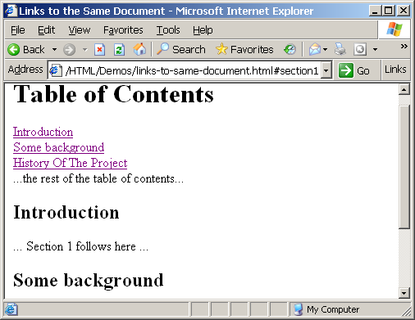
Links to the Same Document – Example (2)
links-to-same-document.html
<h1>Table of Contents</h1>
<p><a href="#section1">Introduction</a><br />
<a href="#section2">Some background</A><br />
<a href="#section2.1">Project History</a><br />
...the rest of the table of contents...
<!-- The document text follows here -->
<h2 id="section1">Introduction</h2>
... Section 1 follows here ...
<h2 id="section2">Some background</h2>
... Section 2 follows here ...
<h3 id="section2.1">Project History</h3>
... Section 2.1 follows here ...

Slide 46


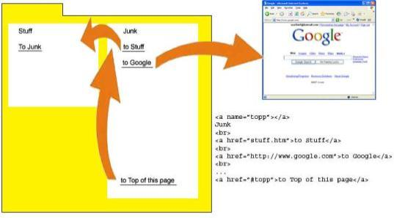
Links to the Same Document
Live Demo

Slide 47
Images: <img> tag
Inserting an image with <img> tag:
Image attributes:
Example:
<img src="/img/basd-logo.png">
src | Location of image file (relative or absolute)
alt | Substitute text for display (e.g. in text mode)
height | Number of pixels of the height
width | Number of pixels of the width
border | Size of border, 0 for no border
<img src="./php.png" alt="PHP Logo" />
‹#›

Slide 48
Miscellaneous Tags
<hr />: Draws a horizontal rule (line):
<center></center>: Deprecated!
<font></font>: Deprecated!
<hr size="5" width="70%" />
<center>Hello World!</center>
<font size="3" color="blue">Font3</font>
<font size="+4" color="blue">Font+4</font>

Slide 49
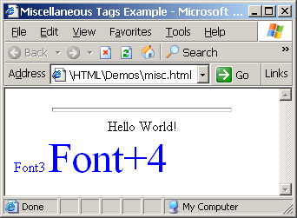
Miscellaneous Tags – Example
misc.html
<html>
<head>
<title>Miscellaneous Tags Example</title>
</head>
<body>
<hr size="5" width="70%" />
<center>Hello World!</center>
<font size="3" color="blue">Font3</font>
<font size="+4" color="blue">Font+4</font>
</body>
</html>

Slide 50


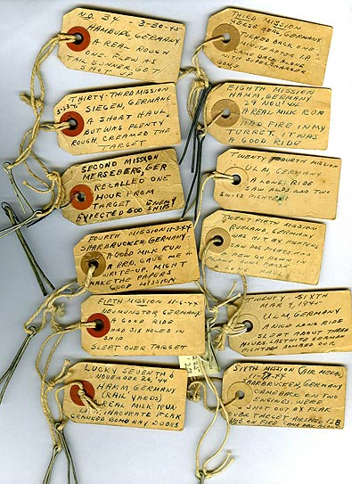
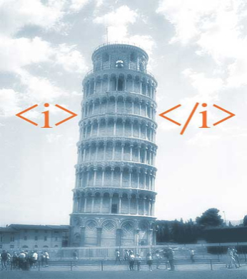
Miscellaneous Tags
Live Demo

Slide 51
Ordered Lists: <ol> Tag
Create an Ordered List using <ol></ol>:
Attribute values for type are 1, A, a, I, or i
<ol type="1">
<li>Apple</li>
<li>Orange</li>
<li>Grapefruit</li>
</ol>
Apple
Orange
Grapefruit
Apple
Orange
Grapefruit
Apple
Orange
Grapefruit
Apple
Orange
Grapefruit
Apple
Orange
Grapefruit

Slide 52
Unordered Lists: <ul> Tag
Create an Unordered List using <ul></ul>:
Attribute values for type are:
disc, circle or square
<ul type="disk">
<li>Apple</li>
<li>Orange</li>
<li>Grapefruit</li>
</ul>
Apple
Orange
Pear
Apple
Orange
Pear
Apple
Orange
Pear

Slide 53
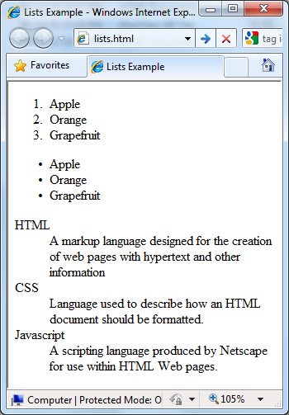
Lists – Example
lists.html
<ol type="1">
<li>Apple</li>
<li>Orange</li>
<li>Grapefruit</li>
</ol>
<ul type="disc">
<li>Apple</li>
<li>Orange</li>
<li>Grapefruit</li>
</ul>
<dl>
<dt>HTML</dt>
<dd>A markup lang…</dd>
</dl>

Slide 54

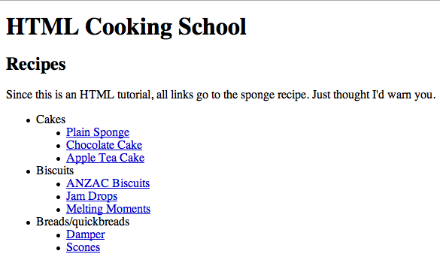

Creating Lists
Live Demo

Slide 55
HTML Special Characters
Symbol Name
HTML Entity
Symbol
Copyright Sign
&copy;
©
Registered Trademark Sign
&reg;
®
Trademark Sign
&trade;
™
Less Than
&lt;
<
Greater Than
&gt;
>
Ampersand
&amp;
&
Non-breaking Space
&nbsp;
Em Dash
&mdash;
—
Quotation Mark
&quot;
"
Euro
&#8364;
€
British Pound
&pound;
£
Japanese Yen
&yen;
¥
‹#›

Slide 56
Special Characters – Example
special-chars.html
<p>[&gt;&gt;&nbsp;&nbsp;Welcome
&nbsp;&nbsp;&lt;&lt;]</p>
<p>&#9658;I have following cards:
A&#9827;, K&#9830; and 9&#9829;.</p>
<p>&#9658;I prefer hard rock &#9835;
music &#9835;</p>
<p>&copy; 2006 by Svetlin Nakov &amp; his team</p>
<p>Telerik Academy™</p>

Slide 57
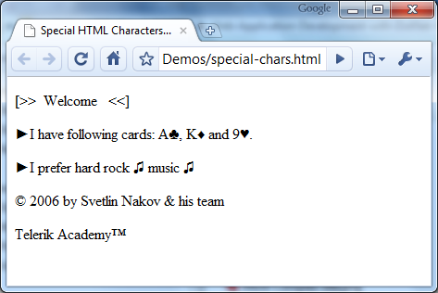
Special Chars – Example (2)
special-chars.html
<p>[&gt;&gt;&nbsp;&nbsp;Welcome
&nbsp;&nbsp;&lt;&lt;]</p>
<p>&#9658;I have following cards:
A&#9827;, K&#9830; and 9&#9829;.</p>
<p>&#9658;I prefer hard rock &#9835;
music &#9835;</p>
<p>&copy; 2006 by Svetlin Nakov &amp; his team</p>
<p>Telerik Academy™</p>

Slide 58
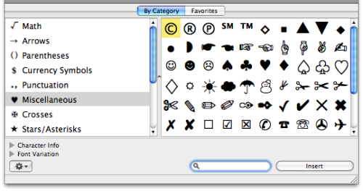
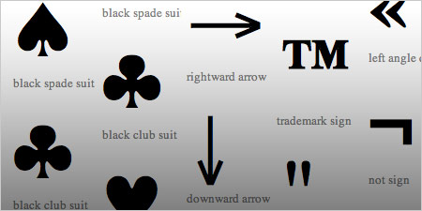
HTML Special Characters
Live Demo

Slide 59
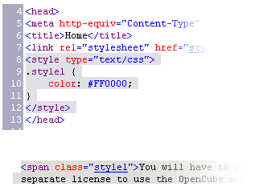

Using <DIV> and <SPAN> Block and Inline Elements

Slide 60
Block and Inline Elements
Block elements add a line break before and after them
<div> is a block element
Other block elements are <table>, <hr>, headings, lists, <p> and etc.
Inline elements don’t break the text before and after them
<span> is an inline element
Most HTML elements are inline, e.g. <a>

Slide 61
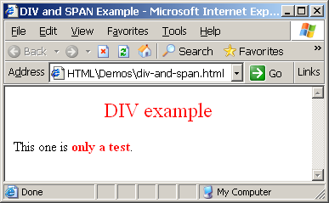
The <div> Tag
<div> creates logical divisions within a page
Block style element
Used with CSS
Example:
div-and-span.html
<div style="font-size:24px; color:red">DIV example</div>
<p>This one is <span style="color:red; font-weight:bold">only a test</span>.</p>

Slide 62


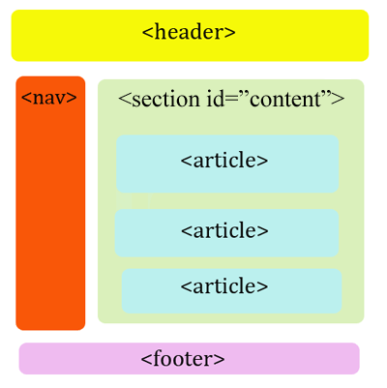
<DIV>
Live Demo
<DIV>

Slide 63
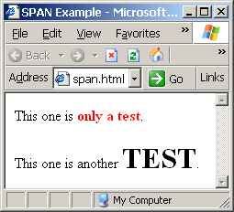
The <span> Tag
Inline style element
Useful for modifying a specific portion of text
Don't create a separate area (paragraph) in the document
Very useful with CSS
span.html
<p>This one is <span style="color:red; font-weight:bold">only a test</span>.</p>
<p>This one is another <span style="font-size:32px; font-weight:bold">TEST</span>.</p>

Slide 64


<SPAN>
Live Demo
<SPAN>some text</span>

Slide 65
<span>
A <span> element which is used to color a part of a text:
<p>Add the <span class="ingredient">basil</span>, <span class="ingredient">pine nuts</span> and <span class="ingredient">garlic</span> to a blender and blend into a paste.</p>

Slide 66
HTML Basics
?
?
HTML, Text, Images, Tables, Forms
?
?
?
Questions?
?
?
?
?
?
http://academy.telerik.com

Slide 67
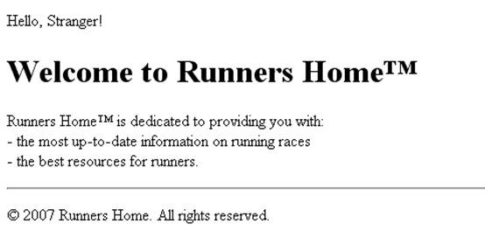
Exercises
Write an HTML page like the following:
* Use headings and divs

Slide 68
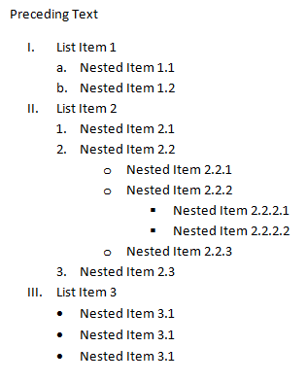
Exercises (2)
Write an HTML page like the following:
Write an HTML page looking like the PNG file named 3.Introduction.PNG. Using the <a> tag add anchors to the corresponding sections in the same page.

Slide 69
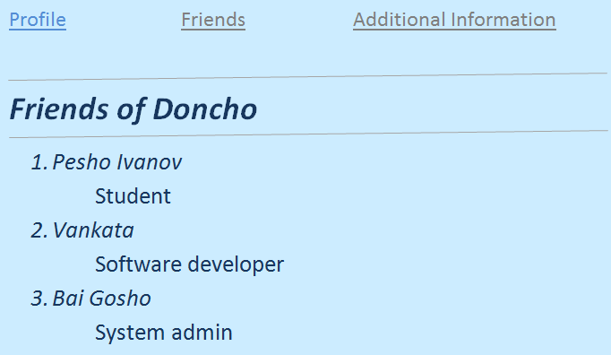
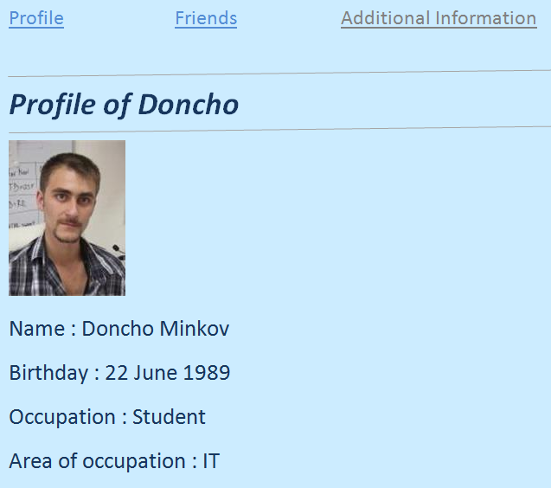
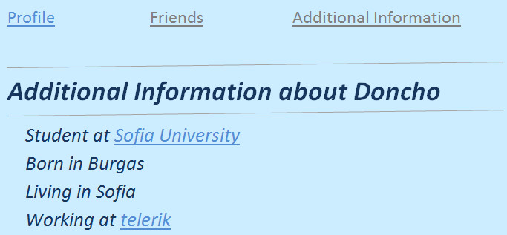
Exercises (3)
Create an user profile Web page Profile.html, friends page named Friends.html and info page named Info.html. Link them to one another using <a> tag.

Slide 70
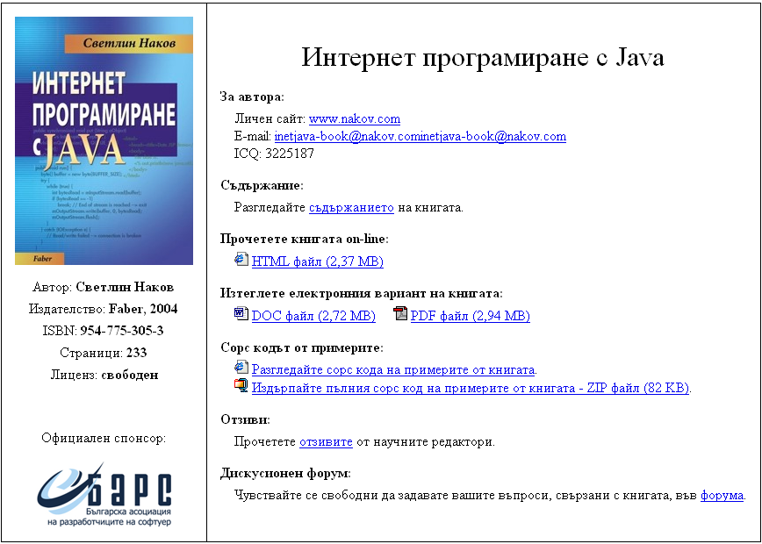
Exercises (4)
Create a Web site like the following:
See the image InetJava-site.png.

